Slide 1




PDS
CI/CD: Streamlining Software Delivery
Computer Vision
https://github.com/siagianp
https://www.youtube.com/@AmelOline/videos
https://github.com/amelcharolinesgn2/Cloud-Infrastructures
https://github.com/amelcharolinesgn2/ClouD-Infrastructure-SISKA-2025
https://github.com/amelcharolinesgn2/CCNA1
https://github.com/amelcharolinesgn2/CCNA2
https://github.com/amelcharolinesgn2/AWS Certificate
Notes:
Lab Session 01: AWS Compute Foundations – EC2, Networking, and Application Deployment Lab Session 02: Identity and Access Control with IAM Lab Session 03: Cloud Storage Solutions – S3, EBS, and EFS Lab Session 04: Database Services – RDS, DynamoDB, and ElastiCache Lab Session 05: Load Balancing and Auto Scaling Lab Session 06: Container Orchestration with ECS, Fargate, and EKS Lab Session 07: Serverless Computing with Lambda Lab Session 08: Monitoring, Logging, and Security Auditing Lab Session 09: Infrastructure as Code – CloudFormation, CDK, and Terraform Lab Session 10: CI/CD Pipelines – App Runner, CodePipeline, GitHub Actions, and CodeDeploy Lab Session 11: AI/ML Services – Rekognition, Comprehend, Translate, and SageMaker Lab Session 12: Hybrid Cloud Networking – VPC Peering, Transit Gateway, VPN, and Direct Connect Lab Session 13: Security and Compliance – AWS Config, GuardDuty, Security Hub, and KMS Lab Session 14: Disaster Recovery and Business Continuity – AWS Backup, Multi-Region, and Failover Lab Session 15: Migration and Modernization – DataSync, DMS, MGN, Containers, and Serverless
Lab Session 16: Cost Management and Optimization – Cost Explorer, Trusted Advisor, Budgets, and Well-Architected
https://www.youtube.com/watch?v=SOTamWNgDKc&t=19604s

Slide 2
CI/CD: Streamlining Software Delivery
From Code to Production with Speed and Confidence

Slide 3
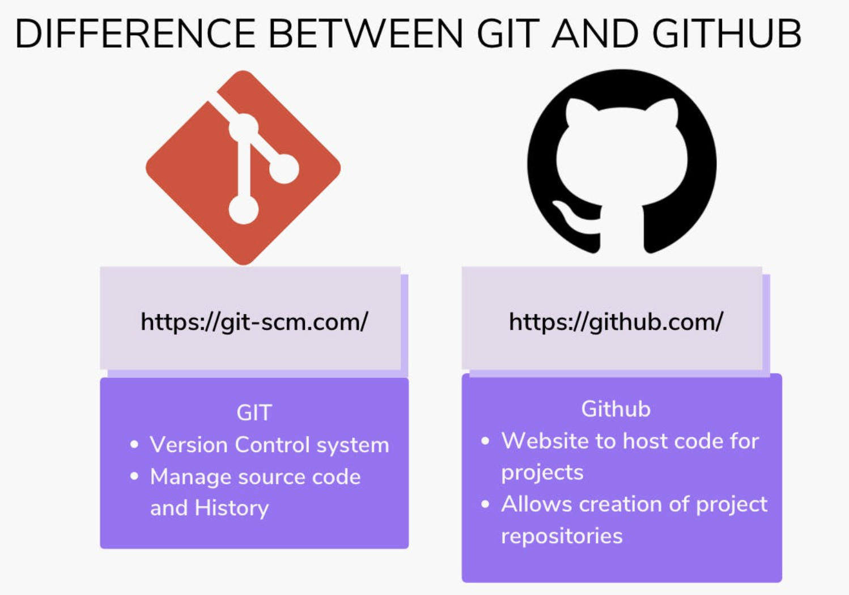

Slide 4
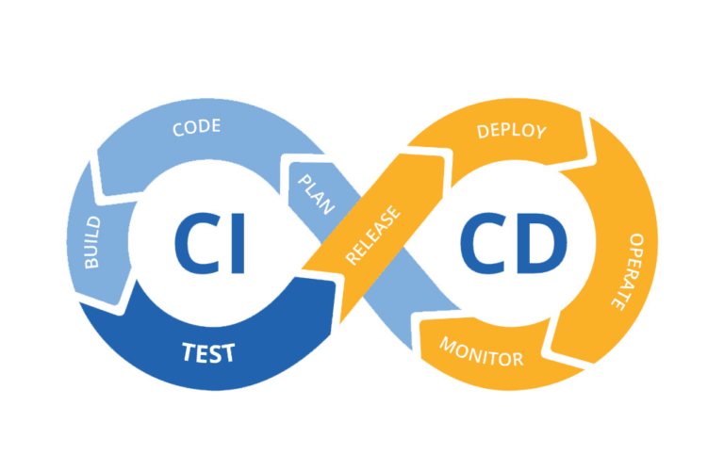
What is CI/CD? (Overview)
CI = Continuous Integration: Frequent code merges + automated testing.
CD = Continuous Delivery (auto-release to staging) or Deployment (auto-release to production).
Goal: Faster, reliable software releases.

Slide 5
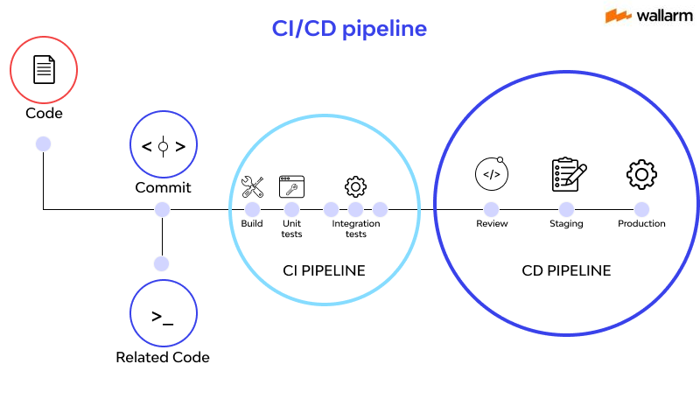

Slide 6
Continuous Integration (CI)
Developers merge code to a shared repo multiple times a day.
Automated build and test workflows catch bugs early.
Tools: Jenkins, GitLab CI, CircleCI.

Slide 7
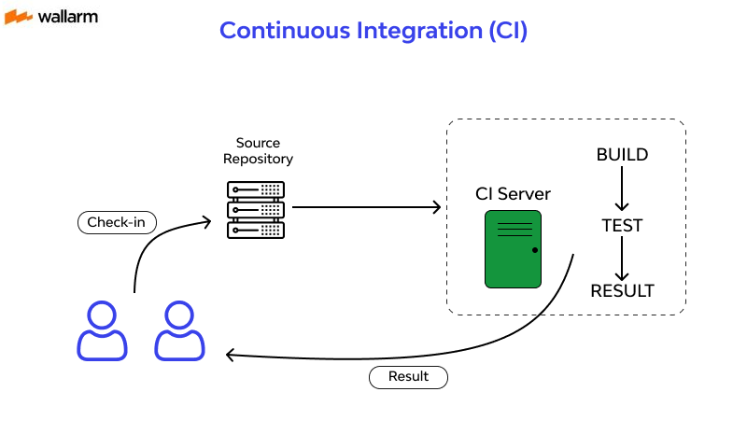
Continuous Integration (CI)

Slide 8
Continuous Delivery vs. Deployment (CD)
Delivery: Automatically deploys to staging for manual approval.
Deployment: Automatically deploys to production (no human intervention).
Example: Netflix uses CD to deploy 1,000+ times/day.

Slide 9
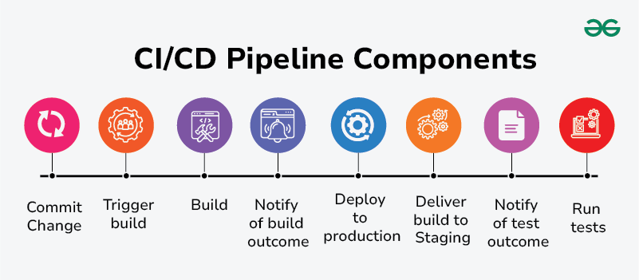
Key Components of CI/CD
Source Code Repo (e.g., GitHub).
Build Server (e.g., Jenkins).
Testing Frameworks (e.g., Selenium).
Deployment Tools (e.g., Kubernetes).
Code commit → 2. Build → 3. Test → 4. Deploy to Staging → 5. Deploy to Production.

Slide 10
Benefits of CI/CD
Faster releases.
Fewer bugs in production.
Better team collaboration.
Scalability for large projects.

Slide 11
Challenges & Pitfalls
Complexity in setup.
Cultural resistance to automation.
Security risks in automated pipelines.

Slide 12
Popular CI/CD Tools
CI/CD Platforms: GitLab, GitHub Actions.
Automation: Jenkins, Travis CI.
Deployment: Docker, AWS CodeDeploy.

Slide 13
Best Practices
Automate everything.
Test in production-like environments.
Monitor pipelines for bottlenecks.

Slide 14
Future of CI/CD
AI-driven test optimization.
GitOps (infrastructure as code).
Serverless CI/CD pipelines.

Slide 15
Conclusion
CI/CD = Faster, safer, collaborative software delivery.
Start small, iterate, and invest in automation.

Slide 16
THANK YOU
Amel charoline
Amel Online & Irene magdalena
https://github.com/siagianp
https://www.youtube.com/@AmelOline/videos
https://github.com/amelcharolinesgn2/Cloud-Infrastructures
https://github.com/amelcharolinesgn2/ClouD-Infrastructure-SISKA-2025
https://github.com/amelcharolinesgn2/CCNA1
https://github.com/amelcharolinesgn2/CCNA2
https://github.com/amelcharolinesgn2/AWS Certificate

